Slide 1
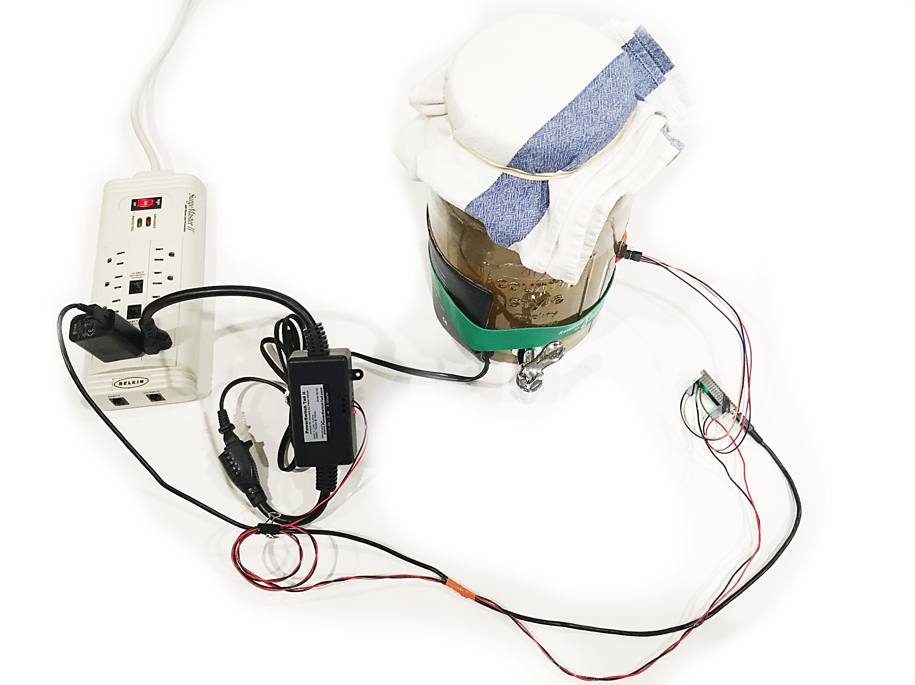
Power Supply
Heater
Thermometer
Micro USB
AC Adapter
Feather M0 Adalogger
PowerSwitch Tail 2

Slide 2

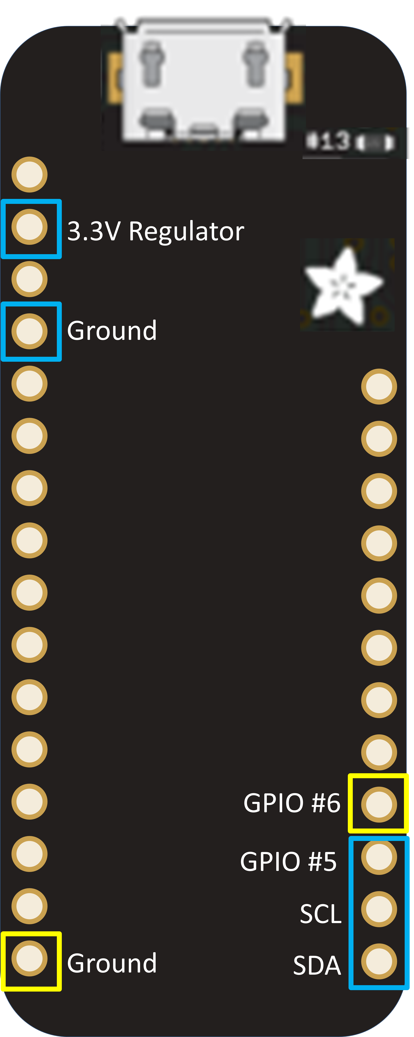
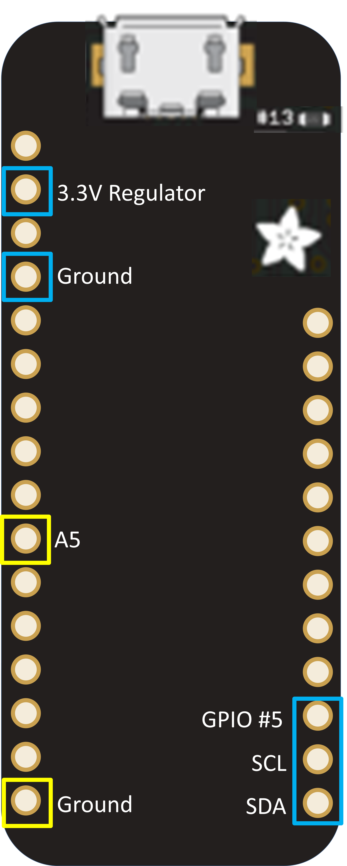
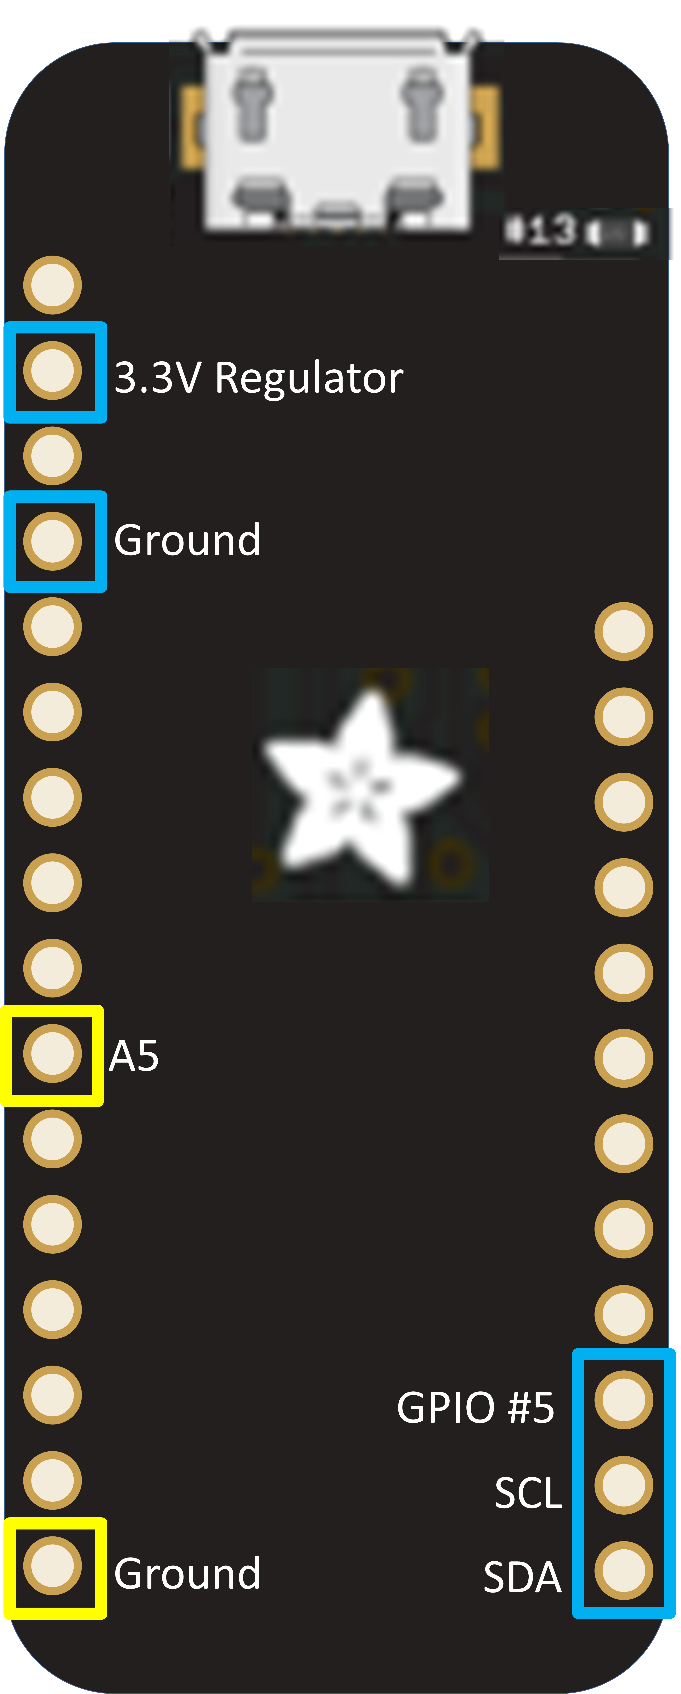
A2
Heater
A1
A0
Thermometer
Alert
SDA
PowerSwitch Tail
1:+in 2:-in 3:Ground
SCL
Ground
Vdd
Feather M0
Adalogger

Slide 3
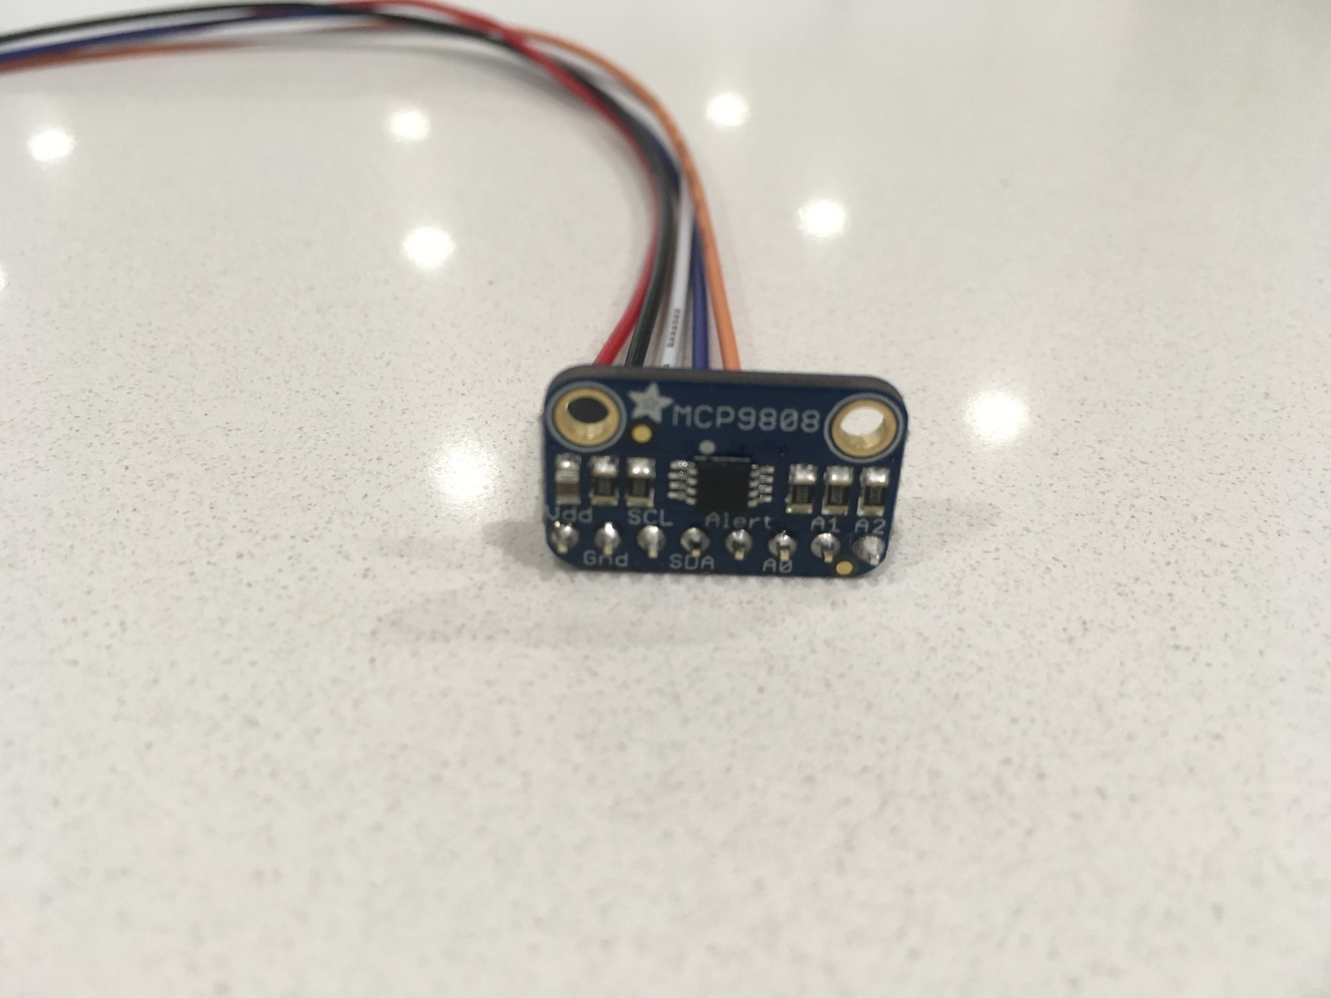
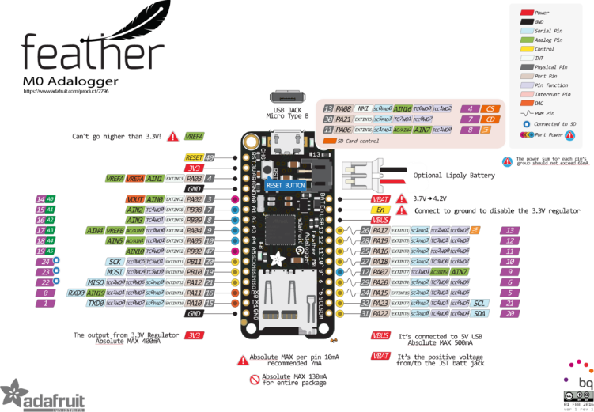
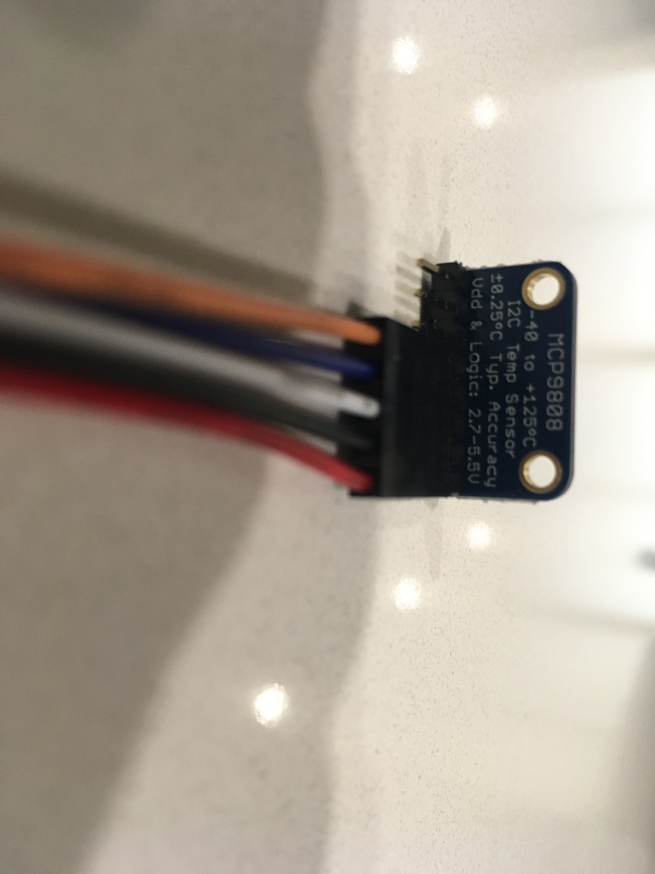
A2
A1
A0
Alert
SDA
SCL
Ground
Vdd
3.3V Regulator
Vdd
Ground
SCL
Ground
SDA
Alert
A5
GPIO #5
SCL
Ground
SDA

Slide 4
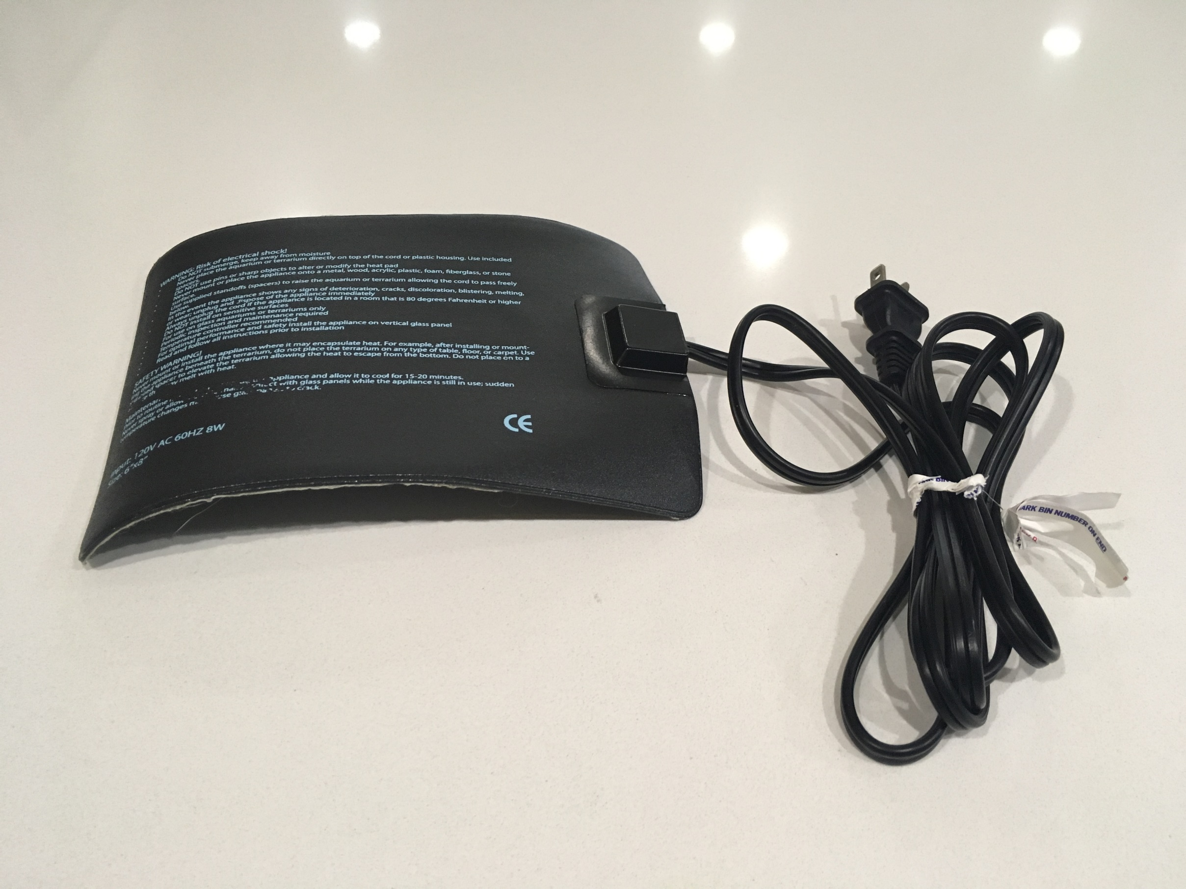
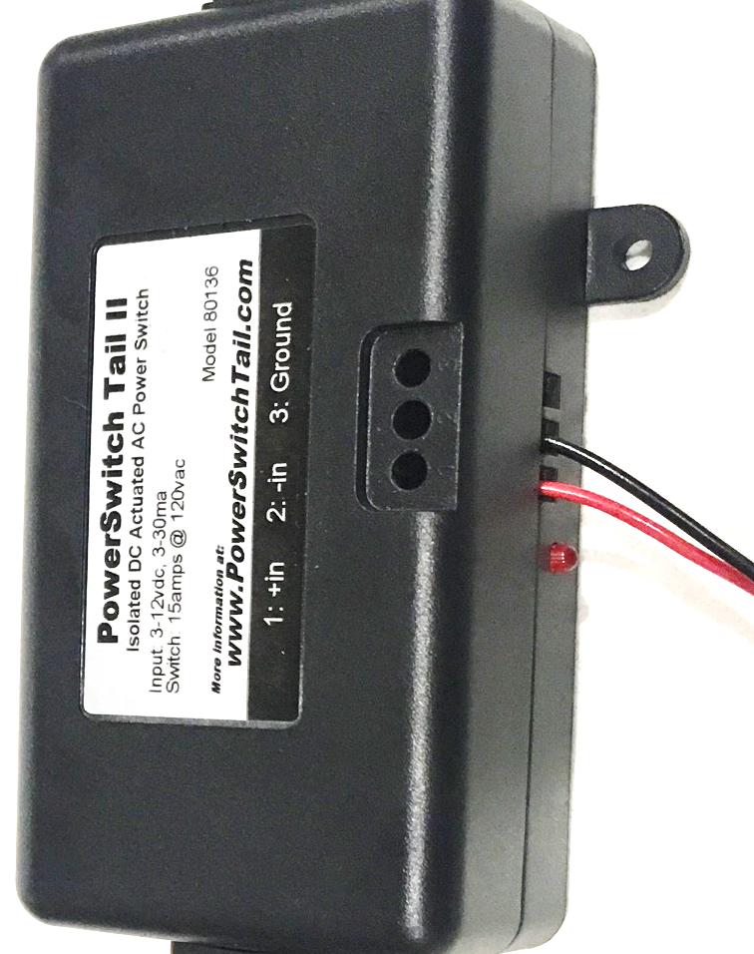
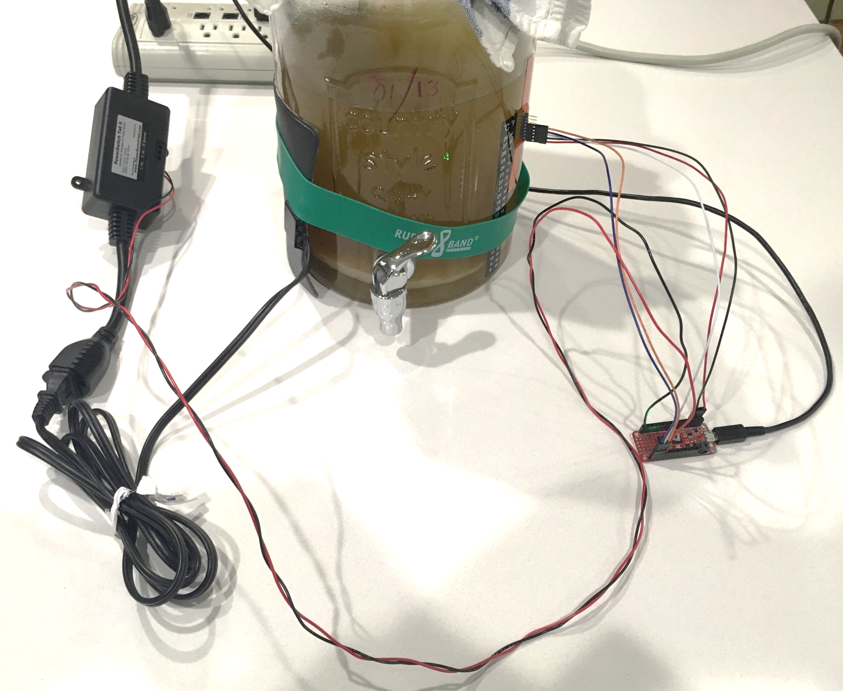
A2
A1
A0
Alert
SDA
SCL
Ground
Vdd

Slide 5
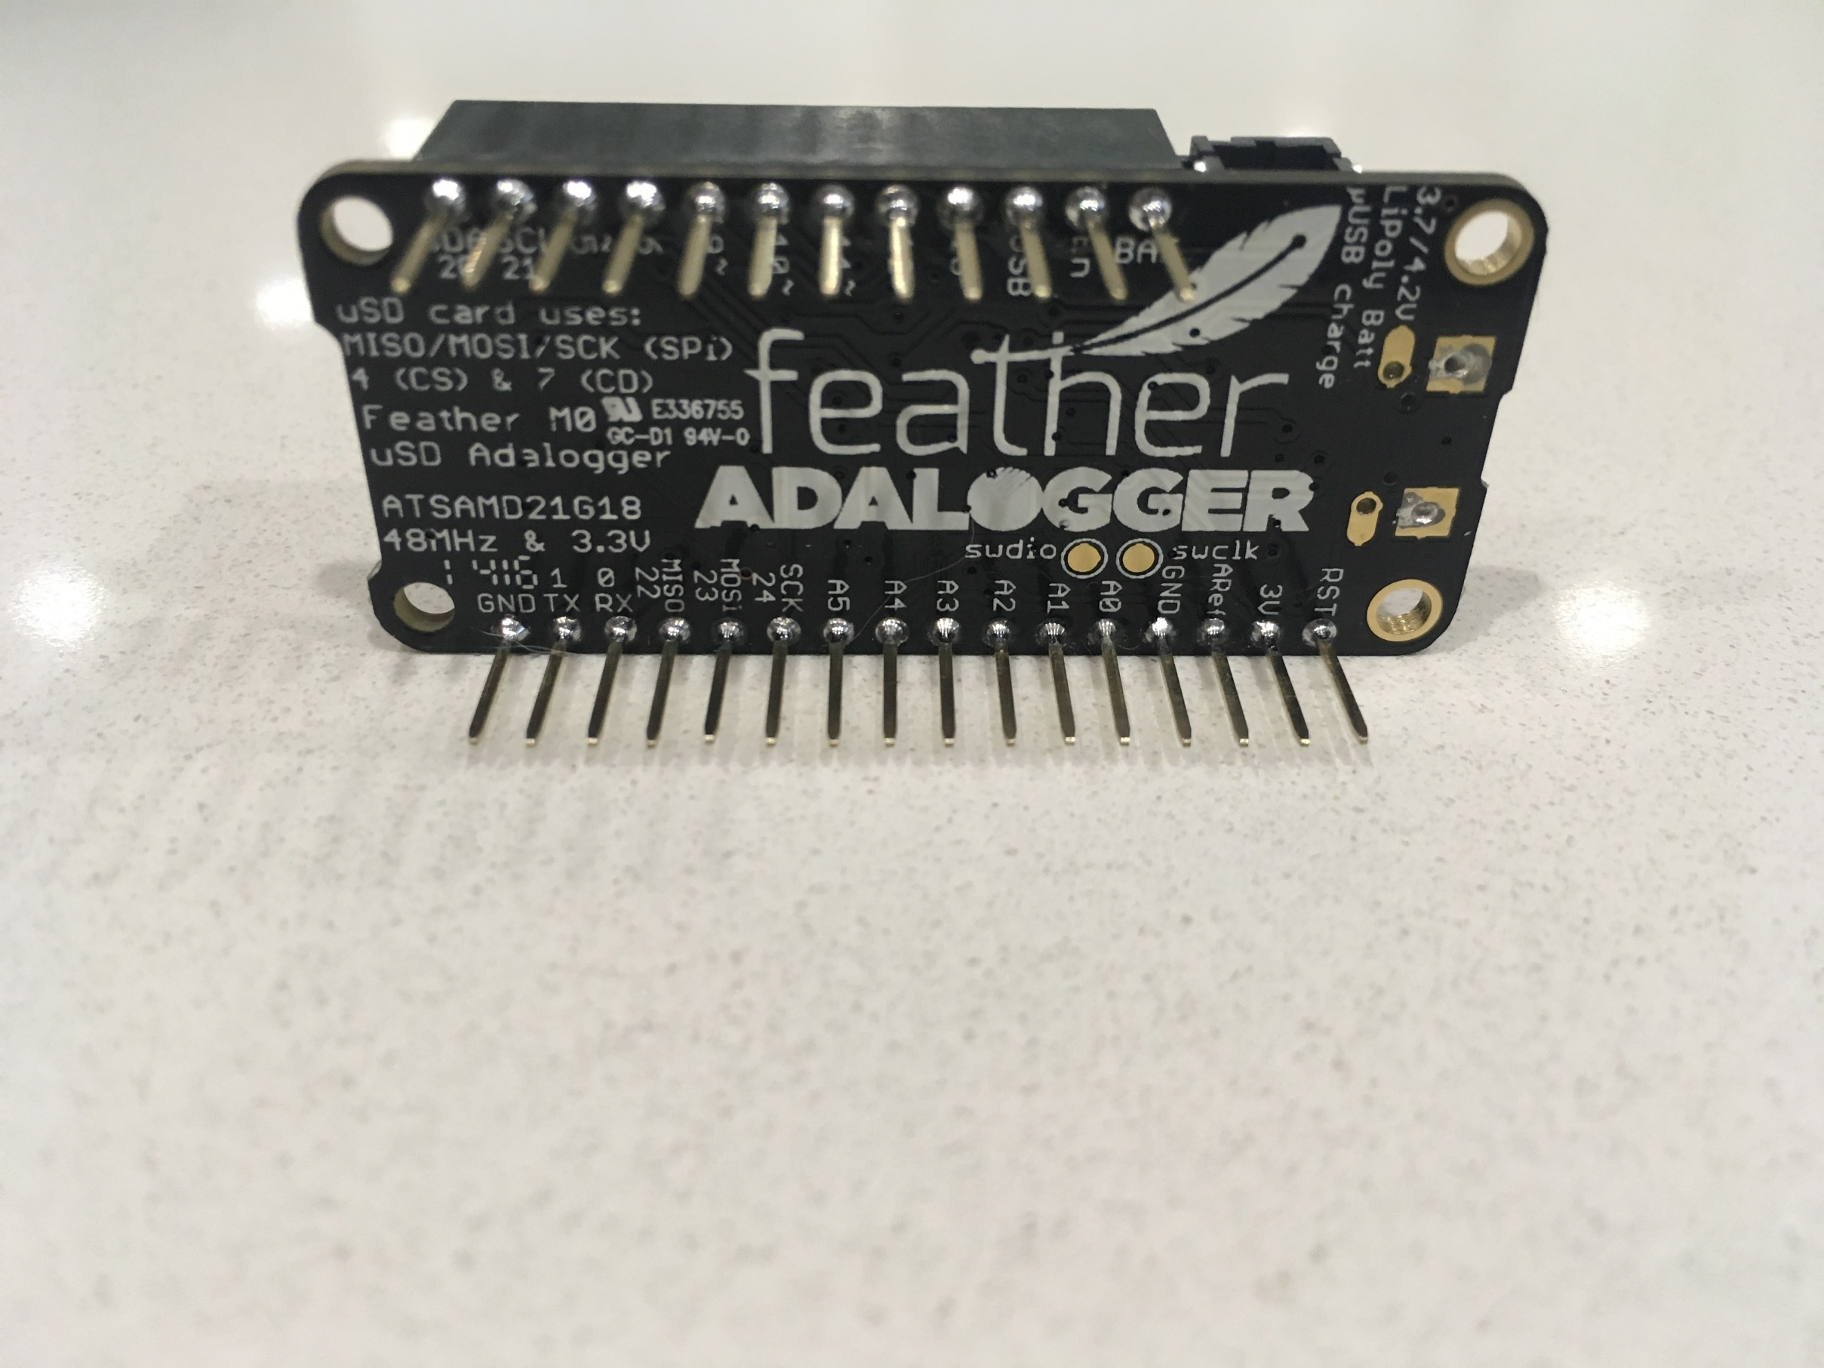

Slide 6
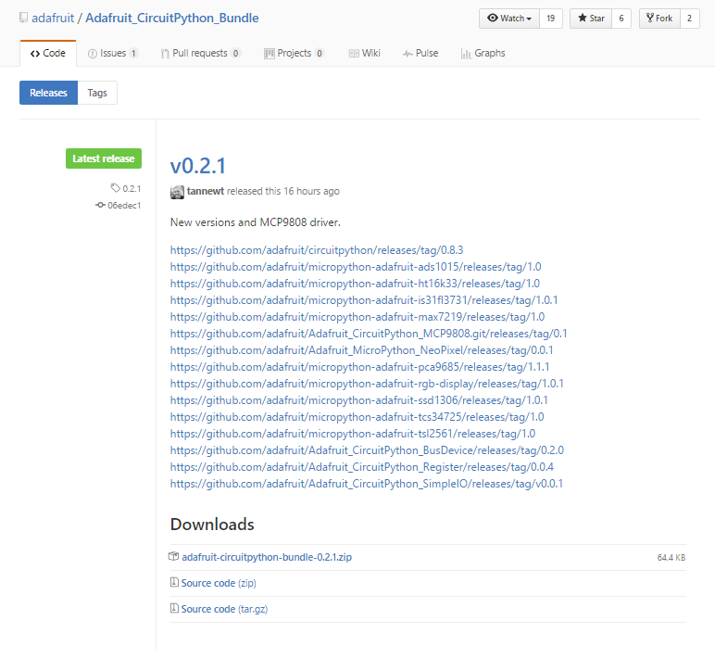

Slide 7
